Slide 1

Department of Information Technology
NBA Accredited A.P. Shah Institute of Technology G.B.Road,Kasarvadavli, Thane(W), Mumbai-400615 UNIVERSITY OF MUMBAI Academic Year 2021-2022

Slide 2
A Project Report on
Flight Fare Prediction System Submitted in partial fulfilment of the degree of Bachelor of Engineering(Sem-6) in INFORMATION TECHNOLOGY By Vedant Patil(19104065) Mudra Limbasia(19104058) Anvit Mirjurkar(19104059) Under the Guidance of Prof. Kiran Deshpande

Slide 3
1.Project Conception and Initiation

Slide 4
1.1 Objectives
To make travelling easy for the passengers.
To provide all the necessary flight details on one platform to minimize efforts and minimize decision making time.
To bring multiple Airlines, flights and their rates at the tip of your finger.
To allow the passengers to book flights according to their convenience of time, rate, location, and stoppage.
To give multiple best suited flight options to the passengers.

Slide 5
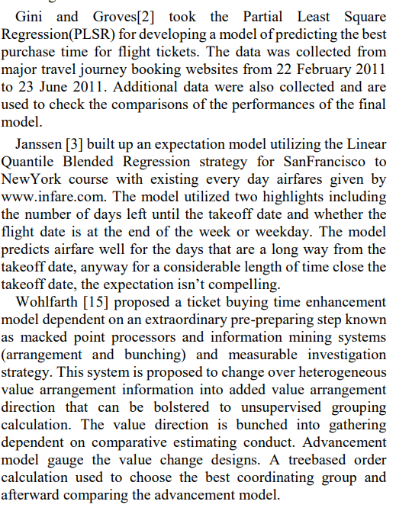
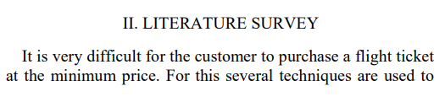
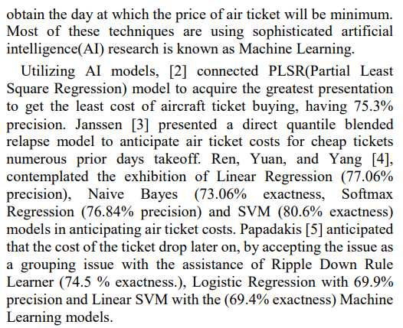
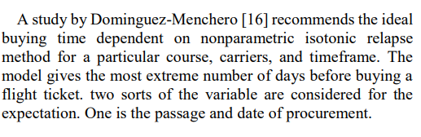
1.2 Literature Review

Slide 6
1.3 Problem Definition
Booking flights is a tedious task as there might be numerous options on various platforms, which makes it hard and confusing to decide.
There are abundant platforms which provide varying rates of flights according to time and stoppage of flights, navigating from one website/app to another to make the right decision is very time consuming and puzzling.

Slide 7
1.4 Scope
The project is a good platform for frequent travellers.
It is useful for all types of passengers as it is user friendly.
It is less time consuming as suitable flights are suggested at one single platform.
It also allows passengers to check predicted flight rates for the near future. As a result they might learn about the best time to book their flights accordingly.

Slide 8
1.5 Technology stack
PYTHON
HTML, CSS
FLASK
JUPYTER NOTEBOOK
GITHUB & GIT
CODE EDITOR

Slide 9
2. Project Design

Slide 10
2.1 Proposed System
The project allows the travellers to check flight rates, according to their travel date, destination and stoppage.
It also allows passengers to check predicted flight rates for the near future. As a result they might learn about the best time to book their flights accordingly.
It brings various Airline companies, and flights at one single platform, which makes it easier for the passengers to choose pocket friendly options.

Slide 11
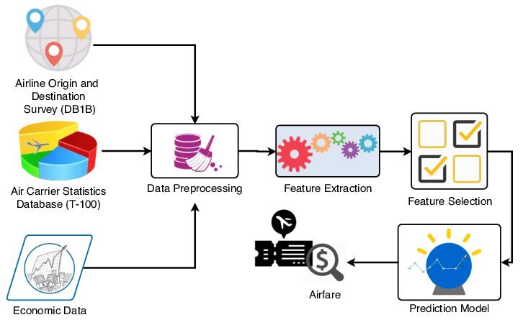
2.2 Design(Flow Of Modules)

Slide 12
2.2 Design(Flow Of Modules)
The first module consists of Airline origin and destination survey, air carrier statistics database and economic data. It is the research process where we have collected the required data for our project.
Next step is data pre-processing. Where training data is pre-processed to transform the raw data into useful and efficient format.
After pre-processing feature extraction and feature selection is done.
The last step is to create a prediction model using AI algorithms. And finally the air fare prediction system is built.

Slide 13
3. Implementation

Slide 14
3.1 Features and Functionality
Flight rate prediction: Rates of Airlines and flights are predicted as per the passengers requirements. Passengers can check flight rates some time prior so that they can book whenever the rates are feasible.
Flight Stoppage: Passengers can choose to travel by taking halts or direct to their destination which may also affect their flight rates, and hence giving them options according to their convenience.

Slide 15
3.2 Algorithms Used
Random forests or random decision forests is an ensemble learning method for classification, regression and other tasks that operates by constructing a multitude of decision trees at training time. For classification tasks, the output of the random forest is the class selected by most trees. For regression tasks, the mean or average prediction of the individual trees is returned. Random decision forests correct for decision trees' habit of overfitting to their training set. Random forests generally outperform decision trees, but their accuracy is lower than gradient boosted trees. However, data characteristics can affect their performance.

Slide 16
3.2 Algorithms Used
Adding one further step of randomization yields extremely randomized trees, or ExtraTrees. While similar to ordinary random forests in that they are an ensemble of individual trees, there are two main differences: first, each tree is trained using the whole learning sample (rather than a bootstrap sample), and second, the top-down splitting in the tree learner is randomized. Instead of computing the locally optimal cut-point for each feature under consideration (based on, e.g., information gain or the Gini impurity), a random cut-point is selected.

Slide 17
3.2 Algorithms Used
This value is selected from a uniform distribution within the feature's empirical range (in the tree's training set). Then, of all the randomly generated splits, the split that yields the highest score is chosen to split the node. Similar to ordinary random forests, the number of randomly selected features to be considered at each node can be specified.
We have used Extra tree regressor in our project, for prediction.

Slide 18
5. Result

Slide 19
5.1 Project Outcomes
User can choose their date of departure, and source and destination.
User can choose stoppage of flight, and their preferred airlines to get the best match of flights available.
User is given best suited flight options according to their travel requirements.

Slide 20
6. Conclusion and Future Scope

Slide 21
6.1 Conclusion
Thus in conclusion, our project would help to save money of inexperienced people by providing them the information related to the trends that the flight rates follow.
It will also give them a predicted value of the price, by which they can decide whether to book ticket immediately or at some later point of time when the cost of ticket is comparatively lower.

Slide 22
6.2 Future scope
Currently there are many fields where machine learning algorithms are used to predict outcomes of certain events, such as a “Stock price prediction system”. Which gives an approximate estimate value of the stock.
Therefore, there is a requirement for such services in the aviation industry too, which can help customers in booking tickets.
More accurate datasets can be used to get more accurate predictions.

Slide 23
References
Machine Learning Basics: Decision Tree Regression - Medium
Flight Fare Prediction Using Machine Learning - Analytics ...
https://medium.com/analytics-vidhya/regression-flight-price-prediction-6771fc4d1fb3

Slide 24
Thank You

